Slide 1
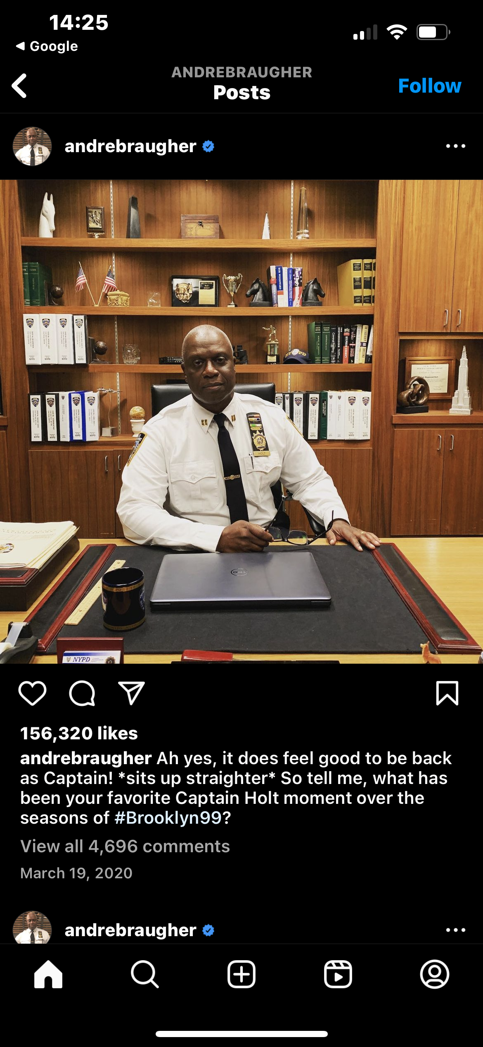
Predictive policing
Is it effective?

Slide 2
Null vs. alternative
Null:
Predictive policing has no effect on crime rates
Alternative:
Predictive policing does affect crime rates

Slide 3

What is predictive policing?
Predictive policing – refers to the use of analytical techniques by law enforcement to make statistical predictions about potential criminal activity.
Can involve either predicting people or events/locations
i.e. perpetrators and victims or types of crimes
Individuals likely to be victims or perpetrators of crimes
Predicting when and where crimes are likely to occur (most common)
Uses “big data” to isolate patterns vs. an officer’s “hunch”
Gather (identify useful data), clean, analyze, action

Slide 4
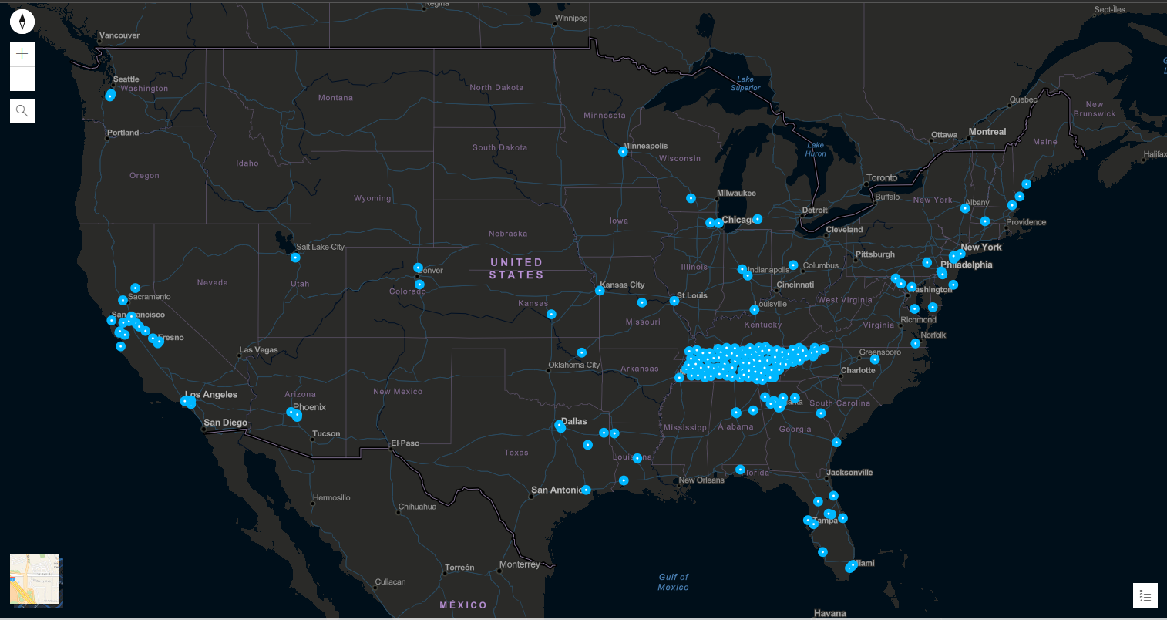
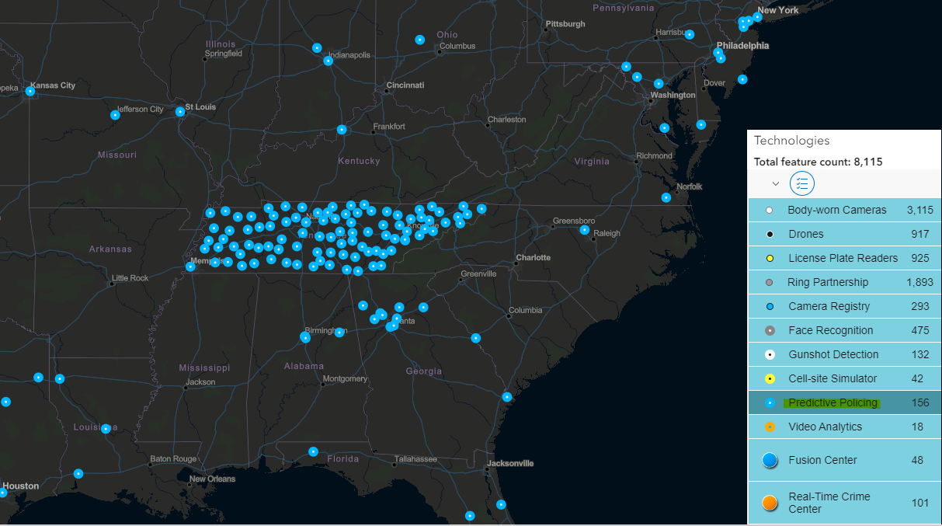
Sample Data
Upon investigation we became aware of a considerable collection of predictive policing hubs in the state of Tennessee according to the Atlas of Surveillance.
.

Slide 5

Predictive policing model
Four stages:
Data collection
Historical data such as when, where, and type - simple
Seasonality and neighborhood composition – more complex
Data analysis
Agencies decide which method to use
They must consider type of crime to target and resources
Police intervention
Supervisors use forecasts to deploy officers
Information is sometimes distributed during briefings
Every act of predictive policing creates new data
Target response
Ebb and flow of police intervention and response of citizens
Crime deterrent, or displacement?

Slide 6

Location based predictive policing
How it works:
Retrospective to be proactive
i.e. residences that are repeatedly burglarized at night
Near-repeat theory suggests crime is more likely to happen in an area after a crime has occurred there
Offenders focus on familiar areas
Safe to assume that crime will continue without police intervention
May displace criminals instead of stopping them

Slide 7

Does location based predictive policing differ from hot spot policing?
Key differences:
1) Hot spot policing uses density maps to plot crimes
Predictive boxes are generated by algorithms
2) Predictive algorithms are shrouded in secrecy
Officers generally understand heat maps
3) Hot spot policing is retrospective
Predictive policing may help to predict crime where it hasn’t occurred before

Slide 8
Person-based predictive policing
How it works:
Law enforcement attempts to predict individuals or groups that may be victims or offenders
Social network analysis
Regression models using risk factors
Issues with person-based policing:
Risk for individuals with no criminal record?
People that are identified as high risk by certain factors could be targeted

Slide 9

Why predictive policing?
Just as in countless other fields, law enforcement is moving more towards data-driven decision making
Actuarials have existed in law enforcement for close to a century
Ernest Burgess of the Chicago School of sociology
Created a parole prediction instrument to calculate the probability of reoffending
Shift towards predictive policing methods
Gained traction in the 1990s, but popularity increased rapidly in the late 2000s
Departments faced pressure to push crime rates lower
Departments were also simultaneously pressured to allocate resources more efficiently

Slide 10
Why predictive policing?
In theory:
The assumption that crime distribution isn’t random
Some believe patterns of crime can be predicted based on factors such as:
Environmental factors
Offenders intentionally select high reward low risk targets
Routine activities
Daily routines trifecta:
Motivated offenders – potential criminals
Suitable targets – personal items in a residence
Absence of capable guardians – people leaving home for the day
Soft targets
Easily victimized people, objects, or places
Elderly, unlocked vehicles, dimly lit residence or abandoned property

Slide 11

A few concerns
Some unanswered questions:
How do we correct biases in the data?
If it can’t be corrected, how does that affect predictions?
Who oversees the overseers?
How does police intervention based on predictions affect subsequent predictions?
Should the standard of reasonable suspicion be raised?
LAPD ended their program in 2021
Investigations revealed that the program led to over-policing of black and brown neighborhoods

Slide 12

Has predictive policing made a quantifiable impact?
How has predictive policing affected crime rates?
What types of crime is predictive policing most effective against?
What types of areas are affected by predictive policing?

Slide 13
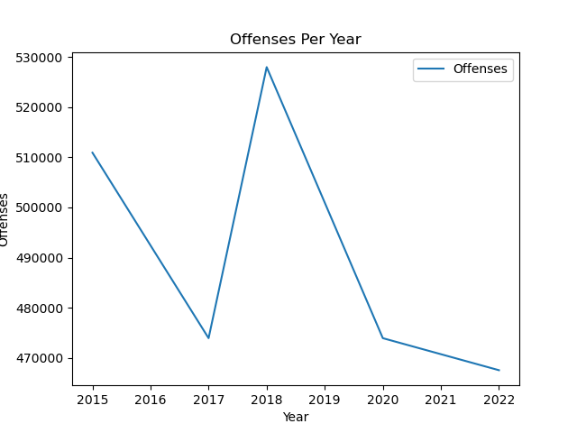
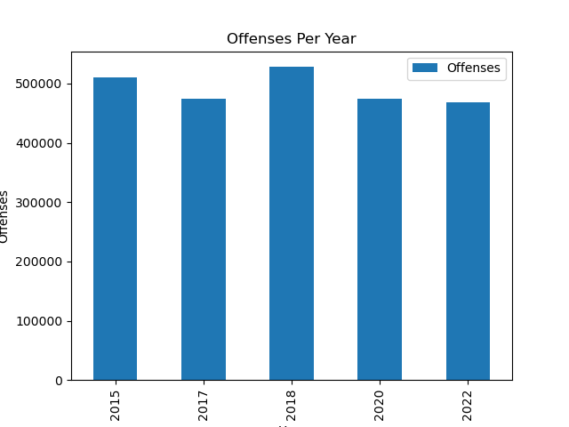
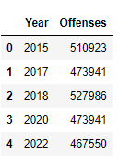
Effect on crime rates
Implemented in 2017 across 95 sheriff’s offices in Tennessee
Uptick in crime in 2018 followed by sharp decline
Graphs suggest that predictive policing is having a positive effect

Slide 14
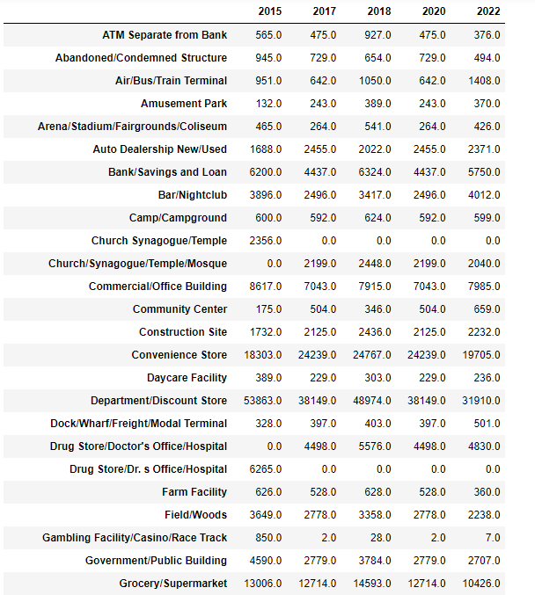
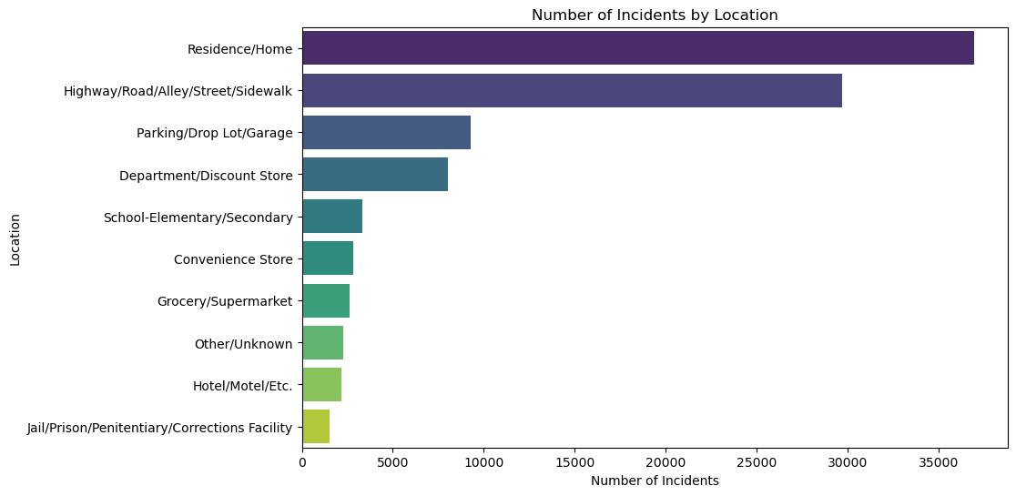
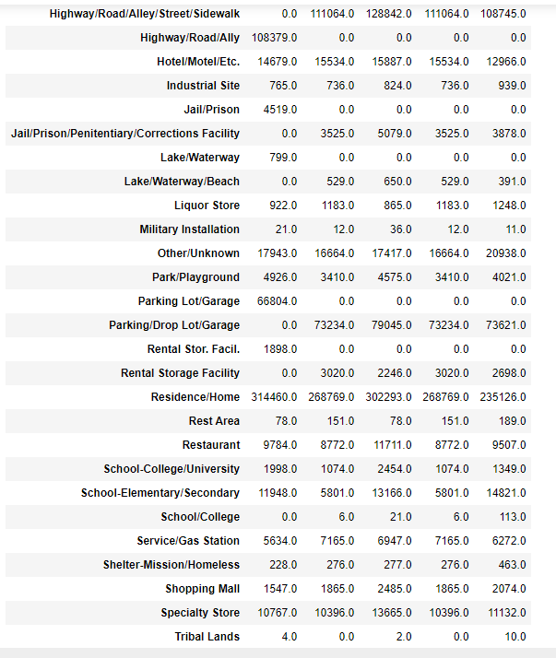
Effect on locations of crimes
Top 10 Locations for Reported Crimes
In general, trending downward
Liquor stores, industrial sites, and freight terminals saw some of the sharpest increases

Slide 15
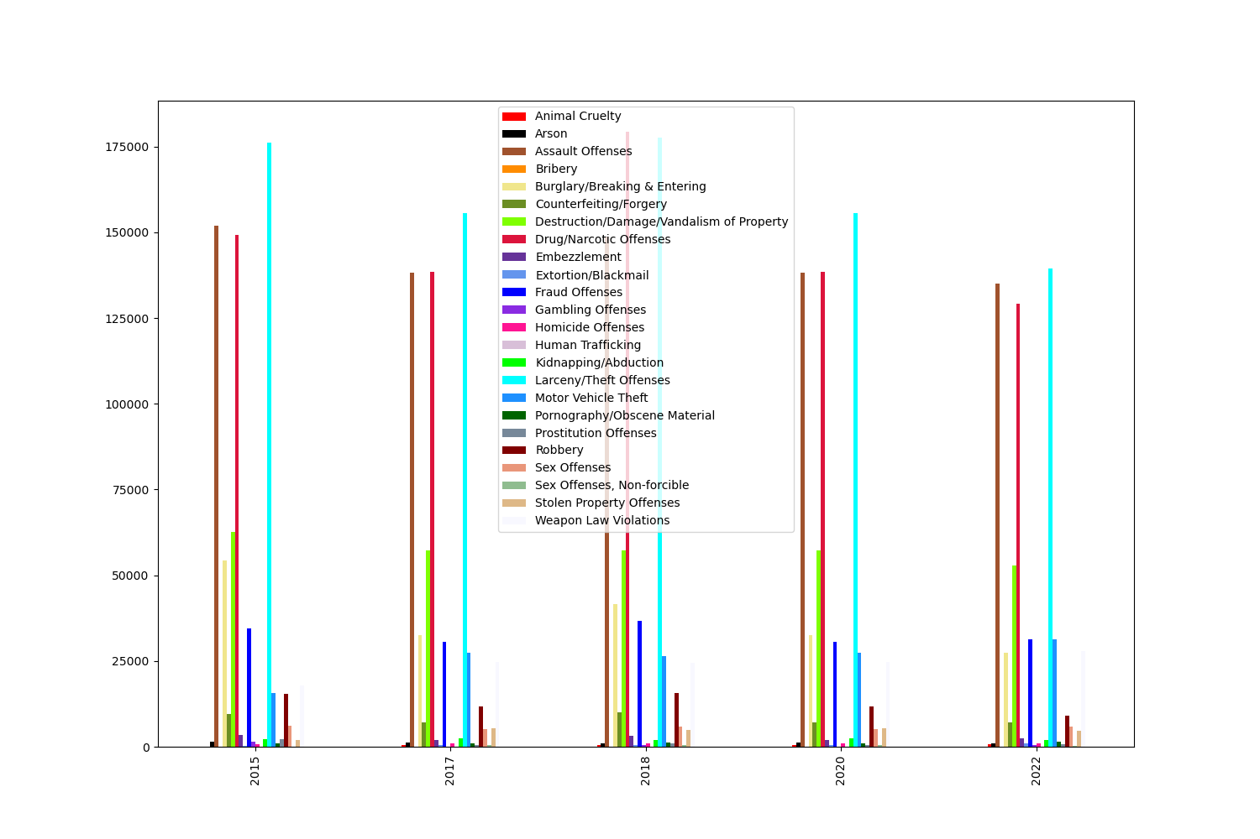
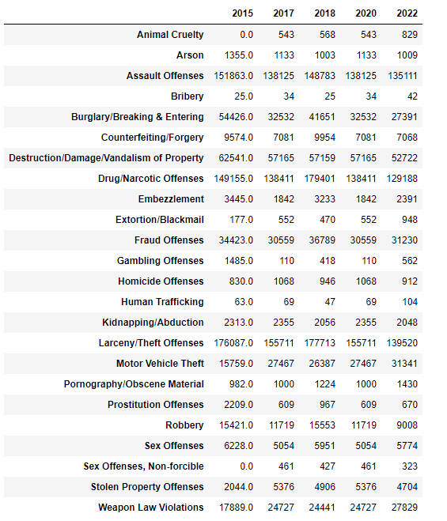
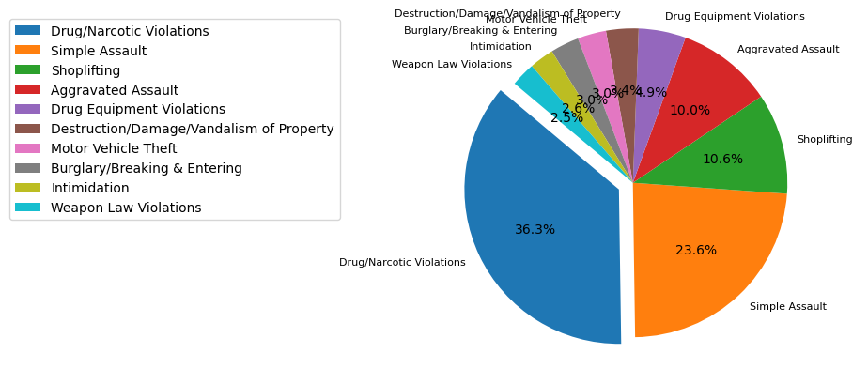
Effect on different types of crimes
Types of Crime Per Year
In general, trending downward
Except for the spike in criminal activity in 2018, the various types of crime appear to have been trending downwards since the implementation of predictive policing.
Top 10 Types in 2022

Slide 16
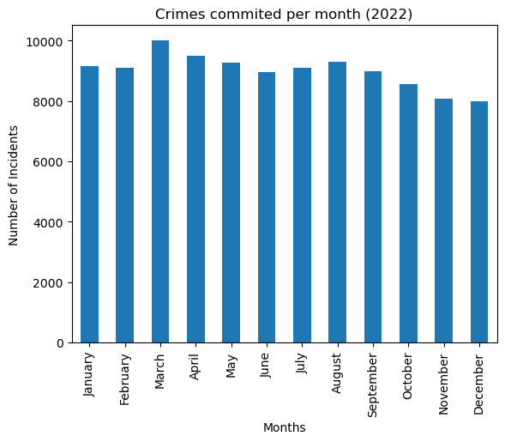
Incidents per month for 2022
According to our collection of data from Tennessee, the trend appears to be showing a gradual decrease in reported criminal activity.

Slide 17
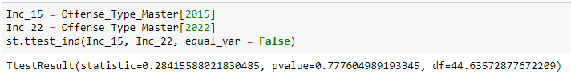
T-Test Results
By running the T-Test to compare 2015 crime statistics against 2022 crime statistics we find a p-value of 0.7776. With the evidence of significant change, we may reject the null hypothesis as crime does appear to be affected by predictive policing.

Slide 18
Resources
Data sources:
https://cde.ucr.cjis.gov/LATEST/webapp/#/pages/downloads#nibrs-downloads
Predictive Policing:
https://www.datacivilrights.org/pubs/2015-1027/Predictive_Policing.pdf
“Predictive Policing” by Sarah Brayne, Alex Rosenblat, and Danah Boyd
Predictive Policing Hub Map:
https://atlasofsurveillance.org/atlas
Atlas of Surveillance; Documenting Police Tech in Our Communities with Open Source Research
Other Such Charts & Graphs:
Cleaned, arranged, and visually analyzed by Kenny Ross, Ray Lamas, & Edward Melville

